Slide 1
ISE390 Data Science Lecture 1 Aug 27th

Slide 2
Office Hours
Name: Martin Radfar
Email: radfar@cs.stonybrook.edu
Office: 131 New CS Building
Hours: TUE 1pm-4pm
http://www.cs.stonybrook.edu/~radfar/CSE391

Slide 3
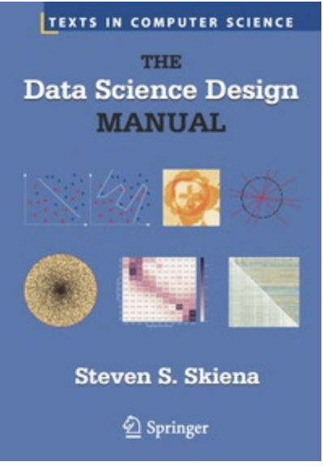
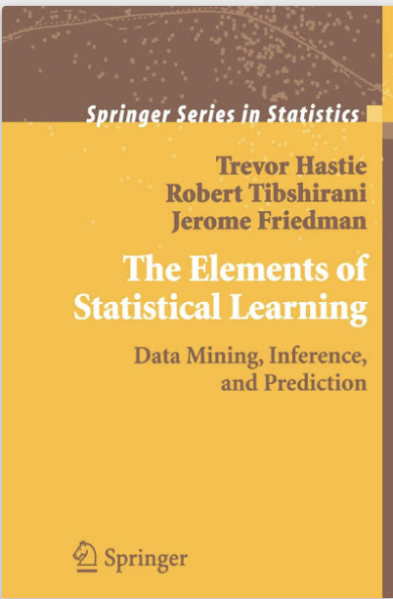
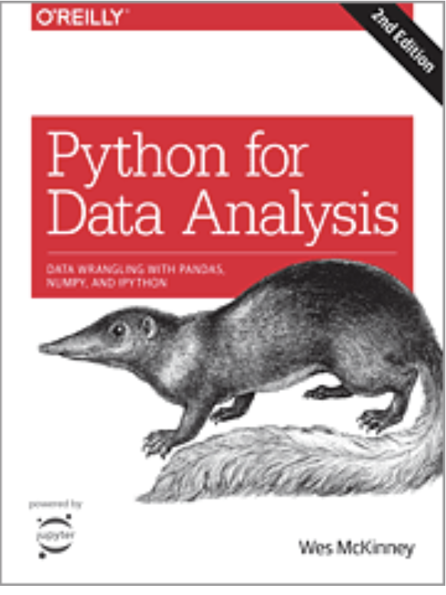
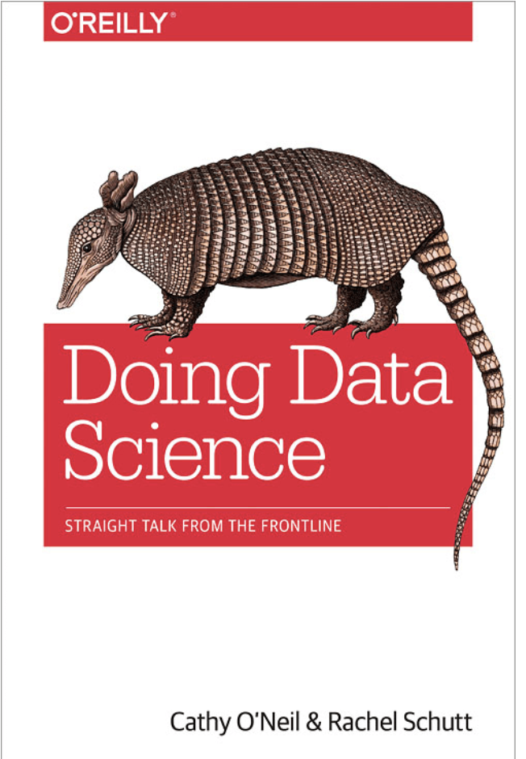
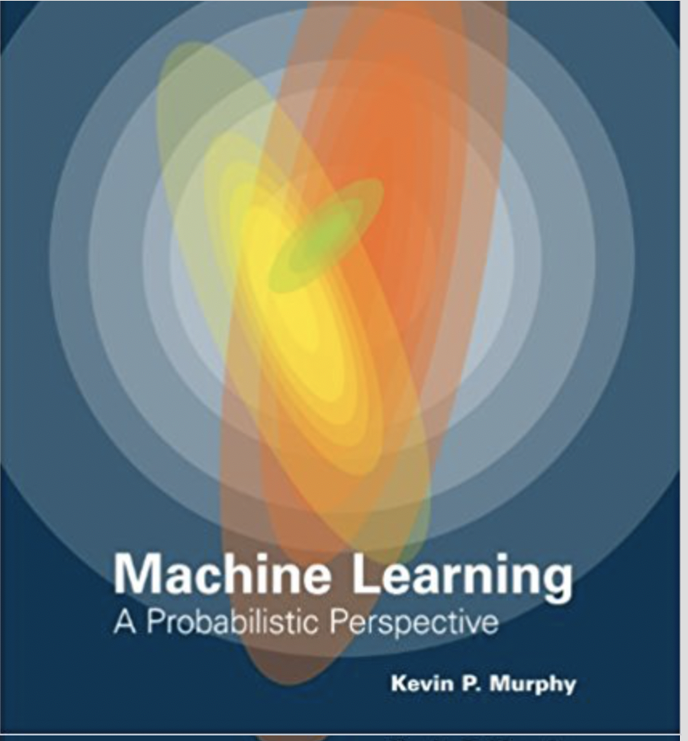
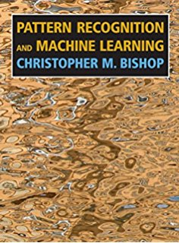
Textbooks

Slide 4
Grading Schema
Assignments and projects 30%
Quizzes: 15%
Midterm : 25%
Finals: 30 %

Slide 5
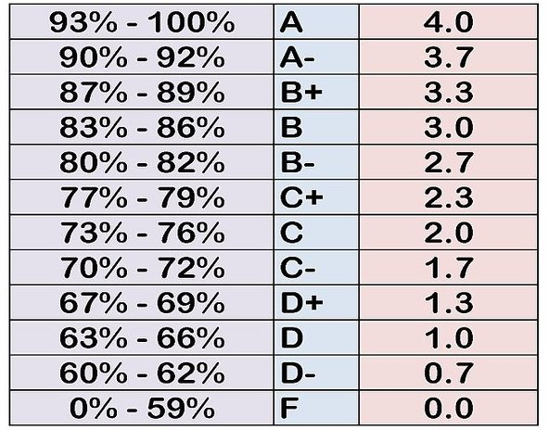
Numeric to letter conversion

Slide 6
Email
When email me, in the title of the email mention the course, i.e. CSE391, otherwise I might ignore your email

Slide 7
Blackboard
Set the blackboard app and turn on the notification
Before emailing me check the blackboard, answer to your question might be posted there.

Slide 8
Piazza
Join the course on Piazza
Used it as a student forum
Don’t post any question directed to me. Email me, meet me during office hours, or email for an appointment

Slide 9
Assignments
Don’t copy assignments, all students involved will get negative grades for copied assignments
Assignments should be submitted electronically
Late assignment policy: For each day late - 20% of the assignment's grade (to a minimum above 0%)

Slide 10
Grade Announcement
Check the Blackboard Grade Center
Quizzes are posted usually within a week or two .

Slide 11
Why should I take this course?
Because you will get a good grade ☺
By 2018 the United States will experience a shortage of 190,000 skilled data scientists, and 1.5 million managers and analysts capable of reaping actionable insights from the big data deluge. McKinsey Report Highlights the Impending Data Scientist Shortage 23 July 2013
Data scientist jobs have been selected by Glassdoor as the most satisfying job and best paid jobs in 2016, 2017, 2018.
We will teach you how become a data scientists --- both theory and programming skills are required.

Slide 12
Do I need a master or PhD to get a data scientist job?
Short answer: if you have one you have better chance
Nonetheless data science would soon become core major in computer science. If your programming skills are good and you work on theory you have a good chance.

Slide 13
Why becoming a data scientist is difficult?
You need to know multiple skills and knowledge
Probability
Linear algebra
Statistics
Machine leaning
Vision and idea to extract knowledge from data
And last but not least programming skills

Slide 14
I don’t know much about these, can I still be a Data scientist?
Short answer: Yes
Well there are many Python libraries to become familiar with data science
These libraries are also a good way to start doing data science without actually understanding data science.

Slide 15
What is the best language to learn
Python is the winner
R was the top choice and still is if you do more statistics
MATLAB best one but issue is money so companies want you to know Python or R.
Java or Scala a few people believe so

Slide 16
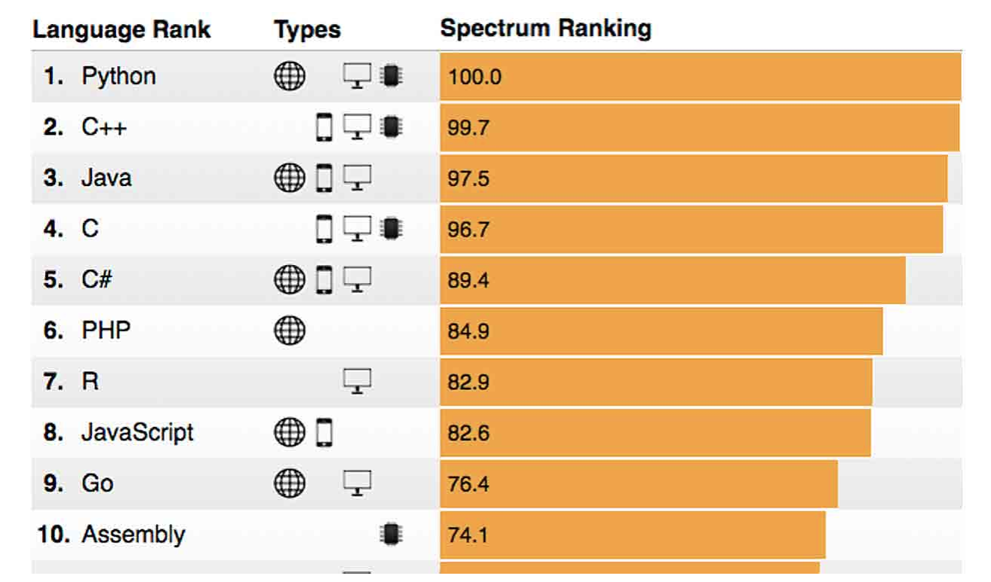
The 2018 Top Programming Languages

Slide 17
What is our approach?
We focus on small problems but try to cover both theory and implementation
You do need to have some preliminary knowledge about probability, stats, linear algebra and basic of Python
We do teach some machine learning topics
We are not looking at ML methods like a black box

Slide 18
Is Data Science new?
No but three things have changed:
Computers are faster
More data are available
Cheap and fast way to store data

Slide 19
Who is a data scientist?
Someone who extracts insights from messy data

Slide 20
4 Types of Data Science Jobs
SCR:UDACITY

Slide 21
Course Topics
Introduction: what is data science?
Mathematics preliminary: probability + statistics review
Tools: Python and scientific libraries
Data munging
Statistics I: Analysis
Visualization
Linear algebra and dimensionality reduction
Linear regression
Supervised learning
Unsupervised learning
Using iPyhton and Jupyter notebook as interactive environments
Implementing machine learning techniques, broadly speaking supervised and unsupervised learning methods and dimensionality reduction using SciKit-Learn
Introduction to deep learning
Natural language processing
Time series analysis using Pandas
Network analysis
Bayesian inference and introduction to Bayesian networks

Slide 22
Course Topics
Using iPyhton and Jupyter notebook as interactive environments
Implementing machine learning techniques, broadly speaking supervised and unsupervised learning methods and dimensionality reduction using SciKit-Learn
Introduction to deep learning
Natural language processing
Time series analysis using Pandas
Network analysis
Bayesian inference and introduction to Bayesian networks

Slide 23
Python Integrated Development Environments (IDE)
Spyder
PyCharm
Rodeo
Pydev with Eclipse
Wing IDE
PTVS
VIM
Jupyter Notebook

Slide 24
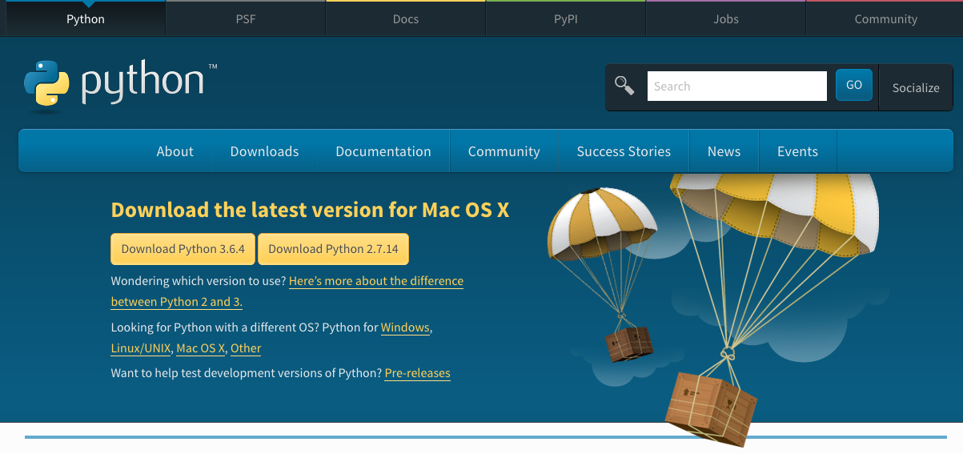
Download Python V3.6.4 from Python.org

Slide 25
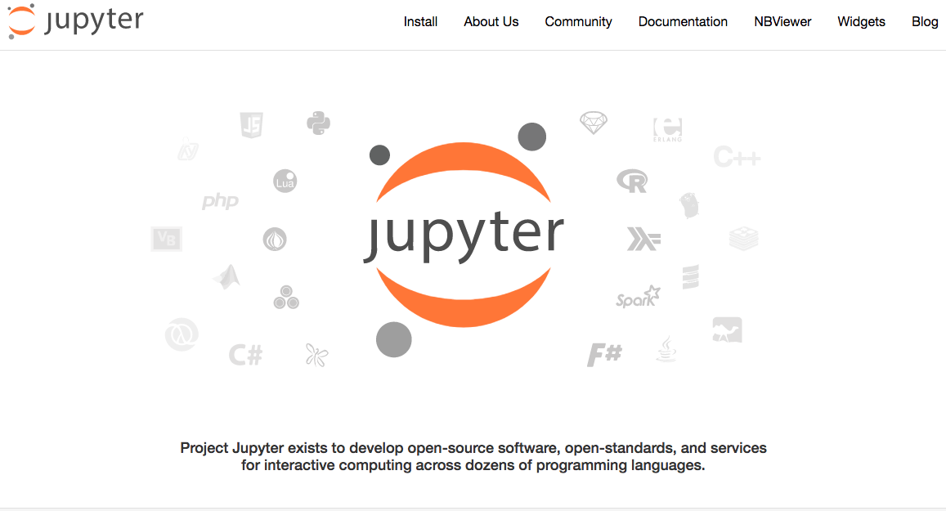
Installing Jupyter using Anaconda

